Slide 1
React State

Slide 2
State
State is the place where the data comes from. We should always try to make our state as simple as possible and minimize the number of stateful components. If we have, for example, ten components that need data from the state, we should create one container component that will keep the state for all of them.

Slide 3
How do you update a component’s state?
State should not be modified directly, but it can be modified with a special method called setState( ).
this.state.id = “2020”; // wrong
this.setState({ // correct
id: "2020"
});

Slide 4
What happens when state changes?
A change in the state happens based on user-input, triggering an event, and so on. Also, React components (with state) are rendered based on the data in the state. State holds the initial information.
So when state changes, React gets informed and immediately re-renders the DOM – not the whole DOM, but only the component with the updated state. This is one of the reasons why React is fast.
The setState( ) method triggers the re-rendering process for the updated parts. React gets informed, knows which part(s) to change, and does it quickly without re-rendering the whole DOM.

Slide 5
Can I use state in every component?
Yes you can use state in every component but don’t complicated your modules with too much of state .
You can create a central parent component which handles the state of all the child component.

Slide 6
Props
Props is short for properties and they are used to pass data between React components. React’s data flow between components is uni-directional (from parent to child only).

Slide 7
How do you pass data with props?
class ParentComponent extends Component {
render() {
return (
<ChildComponent name="First Child" />
);
}
}
const ChildComponent = (props) => {
return <p>{props.name}</p>;
};

Slide 8
Default Props
You can also set default property values directly on the component constructor instead of adding it to the reactDom.render() element.
App.defaultProps = {
headerProp: "Header from props...",
contentProp:"Content from props..."
}

Slide 9
PropTypes
PropTypes exports a range of validators that can be used to make sure the data you receive is valid.
import PropTypes from 'prop-types';
MyComponent.propTypes = {
// You can declare that a prop is a specific JS type. By default, these
// are all optional.
optionalArray: PropTypes.array,
optionalBool: PropTypes.bool,
optionalFunc: PropTypes.func,
optionalNumber: PropTypes.number,
optionalObject: PropTypes.object,
optionalString: PropTypes.string,
optionalSymbol: PropTypes.symbol,
}
https://reactjs.org/docs/typechecking-with-proptypes.html

Slide 10
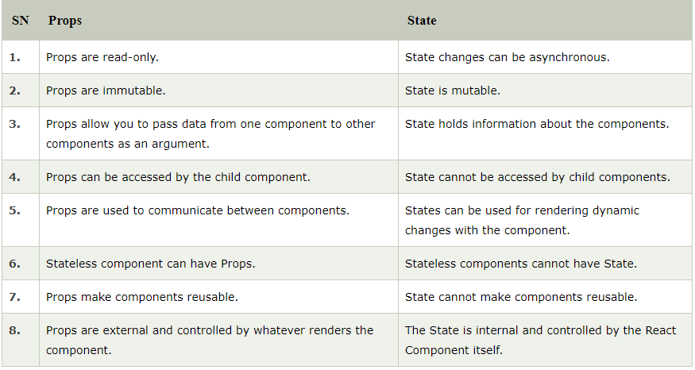
Props vs State

